Slide 1
Keyboard
The keyboard is the piece of computer hardware used to input text, characters, and other commands into a computer or similar device.
keyboard typically contains keys for individual letters, numbers and special characters, as well as keys for specific functions. A keyboard is connected to a computer system using a cable or a wireless connection.
Even though the keyboard is an external peripheral device in a desktop system (it sits outside the main computer housing), or is "virtual" in a tablet PC, it is an essential part of the complete computer system.
Microsoft and Logitech are the probably the most popular physical keyboard manufacturers, but many other hardware makers also produce them.

Slide 2
How keyboard connects to a computer?
computer Keyboard can connect with a computer through a cable or signal(wireless connection). Until recently, a keyboard connects with the standard PS/2 type or Serial.
Now this trend is changed and the connection is replaced by USB (universal serial bus) and wireless connectors. Most modern PCs (motherboards) even don’t have PS/2 connectors, only USB.
Since there is no connection with main pc, wireless keyboard gets power from battery or AC power connection. This is the side effect of wireless keyboards, you often change battery.

Slide 3
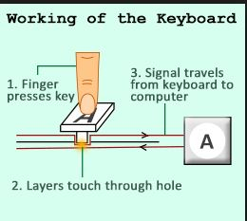
Working of the Keyboard
Figure: Working of the Keyboard

Slide 4
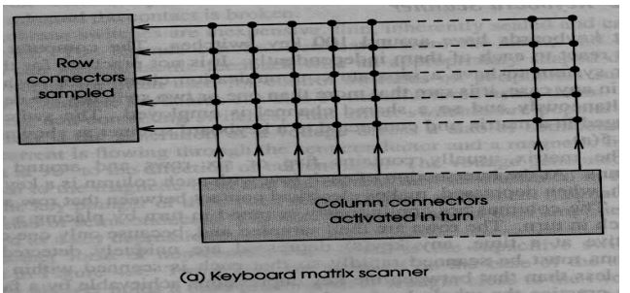
Keyboard Matrix Scanner
Figure: Keyboard Matrix Scanner

Slide 5
Keyboard Matrix Scanner
•Most keyboards have around 100 keys. The computer system must react to each of them independently.
•But it is not possible to have a separate communication channel for each switch.
•So the switches are arranged in a matrix and connected to a keyboard scanner.
•The matrix usually contains 5 or 6 rows and around 20 columns.
•At the intersection of each row with each column is a key switch which ,when depressed ,makes electrical contact between that row and column.

Slide 6
Keyboard Matrix Scanner
•The columns are continuously scanned in turn by placing a voltage on each in turn. •The rows are then sampled and because only one column is active at a time, any key depressed is uniquely detected.
•The columns must be scanned rapidly (far less than a millisecond) so that each is scanned within a time much less than that between the key depressions achievable by a fast typist .
•When a key depression is detected, the key is reported by the keyboard scanner as either a row and column pair of numbers or a single number.

Slide 7
Keyboard Matrix Scanner
•When the key is released this event is similarly reported.
•To ignore the effect of key bounce, the keyboard scanner may choose to ignore the state of a key for a short time after it has been depressed.
•This scan method can report any number of key depressions and releases.

Slide 8
END..

